Slide 1

Transport Layer Part 1
Mark Allman
mallman@case.edu
EECS 325/425
Fall 2018
“Monday when the foreman calls time, I already got Friday on my mind …”

Slide 2
These slides are more-or-less directly from the slide set developed by Jim Kurose and Keith Ross for their book “Computer Networking: A Top Down Approach, 5th edition”.
The slides have been lightly adapted for Mark Allman’s EECS 325/425 Computer Networks class at Case Western Reserve University.
All material copyright 1996-2010
J.F Kurose and K.W. Ross, All Rights Reserved
Allman

Slide 3
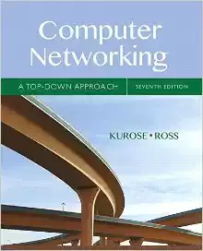
Reading Along ...
Transport layer is chapter 3
Allman

Slide 4









Data Flow
process, e.g., Apache
250 bytes
2750 bytes
HTTP hdr case.png
socket
OS
transport, e.g.,TCP
network, e.g., IP
link, e.g., Ethernet
Allman
4

Slide 5
Data Flow
process, e.g., Apache
250 bytes
2750 bytes
HTTP hdr case.png
socket
OS
transport, e.g.,TCP
network, e.g., IP
Process-to-process communication
link, e.g., Ethernet
Allman
4

Slide 6
Transport Layer
Our goals:
understand
principles behind transport layer services:
multiplexing/ demultiplexing
reliable data transfer
flow control
congestion control (later)
learn about transport layer protocols in the Internet:
UDP: connectionless transport
TCP: connection-oriented transport
Transport Layer
3-

Slide 7
Reading Along ...
3.1:Transport Layer Services
Allman
6

Slide 8









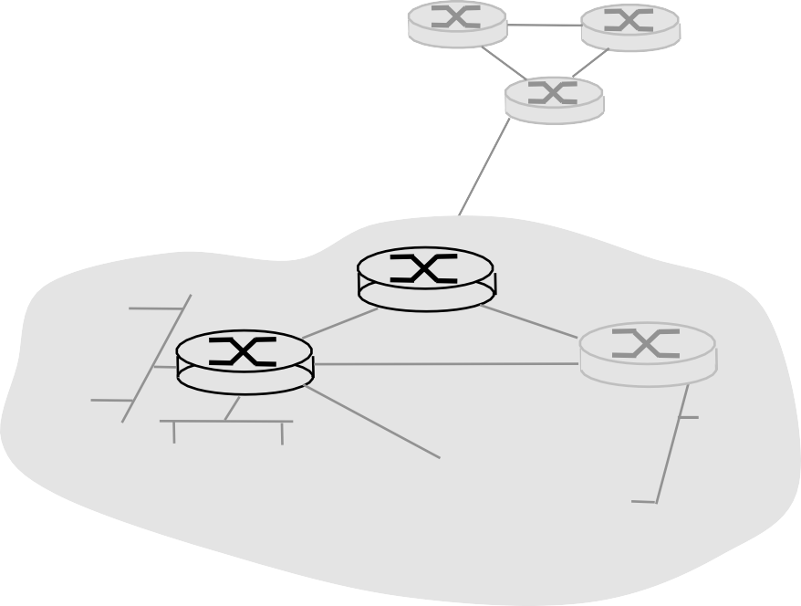







Transport services and protocols
Transport Layer
3-

Slide 9
Transport services and protocols
 provide logical communication between app processes running on different hosts
Transport Layer
3-

Slide 10
Transport services and protocols
 provide logical communication between app processes running on different hosts
transport protocols run in end systems
Transport Layer
3-

Slide 11



Transport services and protocols
 provide logical communication between app processes running on different hosts
transport protocols run in end systems
application
transport
network
data link
physical
application
transport
network
data link
physical
Transport Layer
3-

Slide 12
Transport services and protocols
 provide logical communication between app processes running on different hosts
transport protocols run in end systems
application
transport
network
data link
physical
logical end-end transport
application
transport
network
data link
physical
Transport Layer
3-

Slide 13
Transport services and protocols
 provide logical communication between app processes running on different hosts
transport protocols run in end systems
 send side: breaks app messages into segments, passes to network layer
application
transport
network
data link
physical
logical end-end transport
application
transport
network
data link
physical
Transport Layer
3-

Slide 14
Transport services and protocols
 provide logical communication between app processes running on different hosts
transport protocols run in end systems
 send side: breaks app messages into segments, passes to network layer
application
transport
network
data link
physical
logical end-end transport
application
transport
network
data link
physical

rcv side: reassembles segments into messages, passes to app layer
Transport Layer
3-

Slide 15
Transport services and protocols
 provide logical communication between app processes running on different hosts
transport protocols run in end systems
 send side: breaks app messages into segments, passes to network layer
application
transport
network
data link
physical
logical end-end transport
application
transport
network
data link
physical
rcv side: reassembles segments into messages, passes to app layer
more than one transport protocol available to apps
 Internet: TCP and UDP

Transport Layer
3-

Slide 16
Transport vs. network layer
Transport Layer
3-

Slide 17
Transport vs. network layer
network layer: logical communication between hosts
transport layer: logical communication between processes
 relies on, enhances, network layer services
Transport Layer
3-

Slide 18
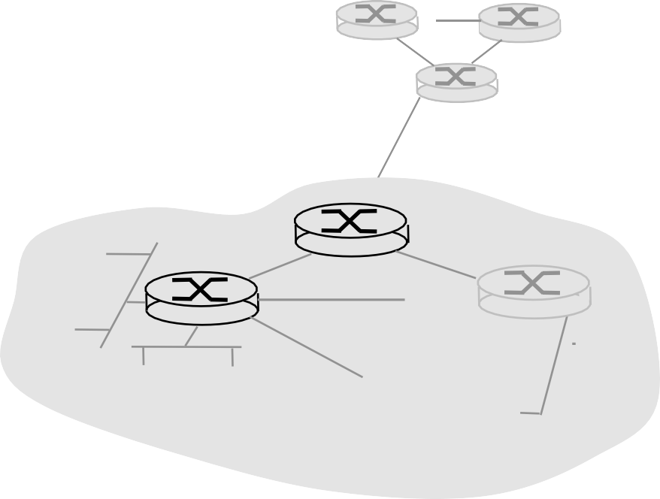
Internet transport-layer protocols
reliable, in-order delivery (TCP)
congestion control
flow control
connection setup
unreliable, unordered delivery: UDP
no-frills extension of “best-effort” IP
services not available:
delay guarantees
bandwidth guarantees
application
transport
network
data link
physical
network
data link
network
physical
data link
physical
logical end-end transport
network data link physical
net
work
data link physical
network
data link
application
physical
network
transport
data link
network
physical
data link
physical
Transport Layer
3-

Slide 19
Reading Along ...
3.2: Multiplexing and Demultiplexing
Allman
10

Slide 20
Multiplexing/demultiplexing
= socket
= process
application P3
transport
network
link
physical
P1
P2
P4
application
P1 application
transport
transport
network
network
link
link
ph
y
sical
physical
host 1
host 2
host 3
Transport Layer
3-

Slide 21
Multiplexing/demultiplexing
Multiplexing at send host: collecting data from sockets, enveloping data with header (later used for demultiplexing)
= socket
= process
application P3
transport
network
link
physical
P1
P2
P4
application
P1 application
transport
transport
network
network
link
link
ph
y
sical
physical
host 1
host 2
host 3
Transport Layer
3-

Slide 22
Multiplexing/demultiplexing
Demultiplexing at rcv host:
Multiplexing at send host:
delivering received segments to correct socket
collecting data from sockets, enveloping data with header (later used for demultiplexing)
= socket
= process
application P3
transport
network
link
physical
P1
P2
P4
application
P1 application
transport
transport
network
network
link
link
ph
y
sical
physical
host 1
host 2
host 3
Transport Layer
3-

Slide 23
How demultiplexing works
host receives IP datagrams
each datagram has source IP address, destination IP address
each datagram carries 1 transport-layer segment
each segment has source, destination port number
host uses IP addresses, IP protocol number & port numbers to direct segment to appropriate socket
32 bits
source port # dest port #
other header fields
application data (message)
TCP/UDP segment format (red = transport header)
Transport Layer
3-

